Slide 1
Numerical Simulation of the 2D Ising Model Using the Metropolis Algorithm
A powerful technique in statistical mechanics for understanding phase transitions in ferromagnetic materials.
Isabelle Byrne

Slide 2
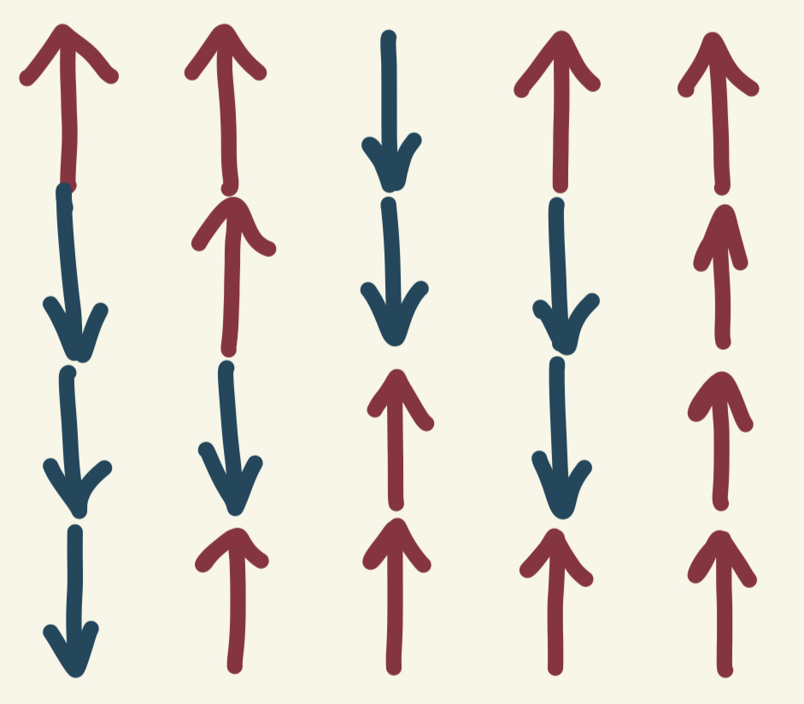
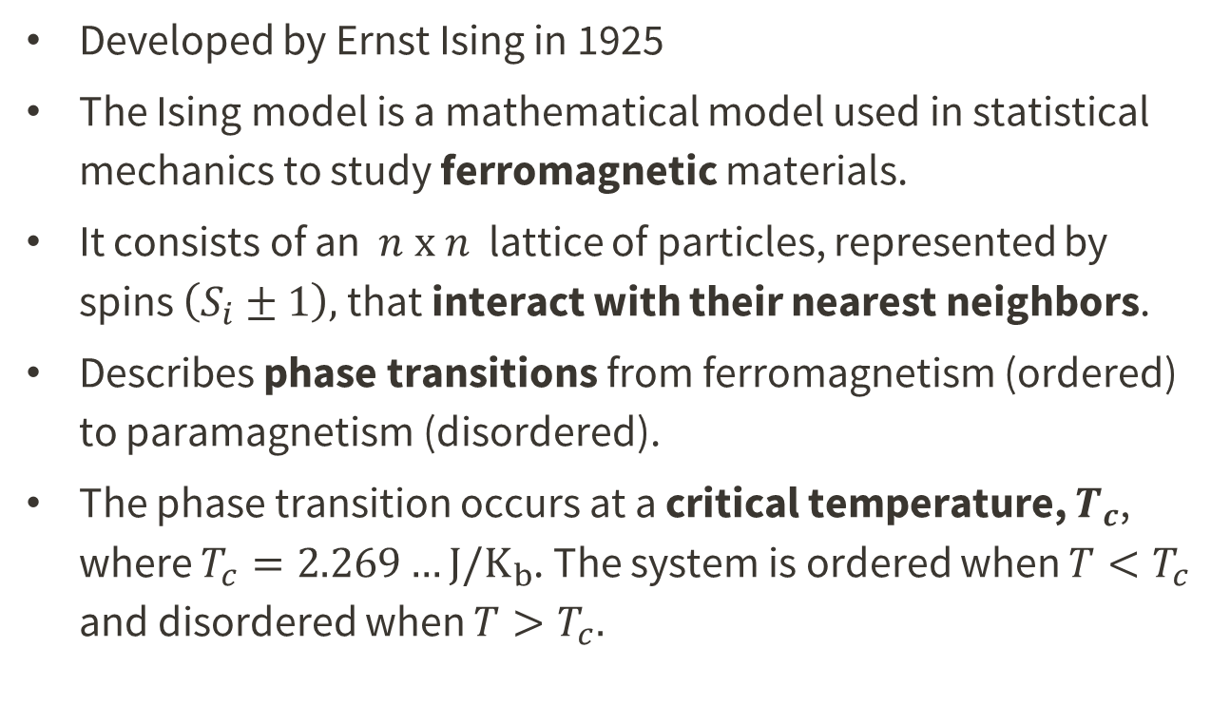
Introduction – The Ising Model
Developed by Ernst Ising in 1925
The Ising model is a mathematical model used in statistical mechanics to study ferromagnetic materials.
It consists of an $n \text{x} n$ lattice of particles, represented by spins $\left(S_{i}±1\right),$ that interact with their nearest neighbors.
Describes phase transitions from ferromagnetism (ordered) to paramagnetism (disordered).
The phase transition occurs at a critical temperature, $T_{c}$, where $T_{c}=2.269…J/K_{b}$. The system is ordered when $T<T_{c}$ and disordered when $T>T_{c}.$
Ferromagnetism
occurs when electron spins spontaneously align parallel to each other, creating a net magnetic moment below a critical temperature. For example, Iron is ferromagnetic below 1043K (770°C), meaning it maintains a magnetic moment even in the absence of an external magnetic field, which is why it can be used to make permanent magnets and is attracted to magnetic fields.
Notes:
-Ising gave credit to Wilhelm Lenz for inventing the model in his PhD thesis where the model was first proposed. Ising earned the name for it regardless.

Slide 3
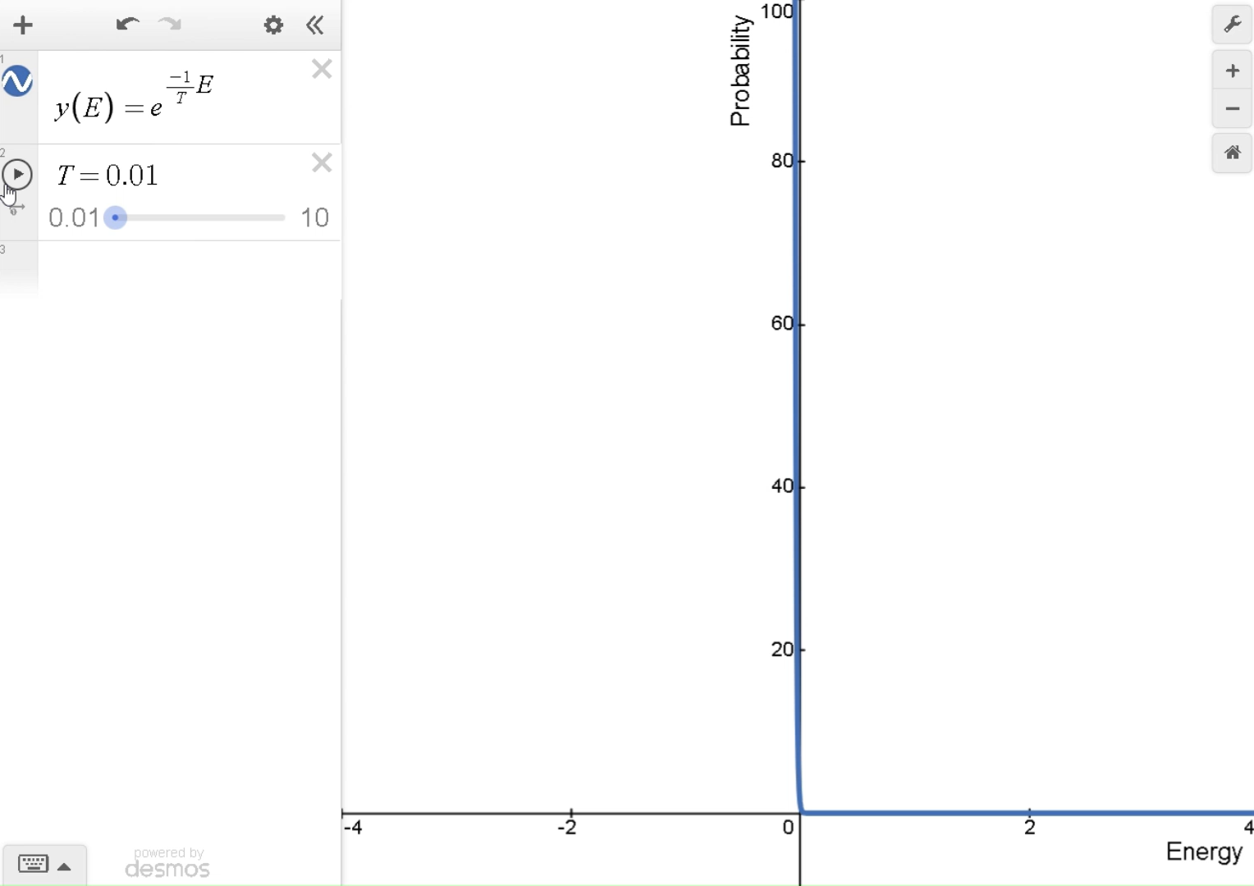
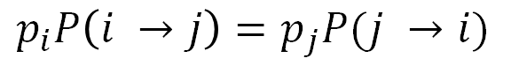



Introduction – Statistical Mechanics
Statistical Mechanics
utilizes a powerful probability function for systems in thermodynamic equilibrium via the partition function:
Partition Function
Probability Function
$$Z= \sum_{i}{e^{−βE_{i}}}$$
$$P_{μ}=\frac{1}{Z}e^{−βE_{μ}}$$
This probability is known as the Boltzmann distribution, where $β=1/k_{B}T$. It shows that:
States with lower energy are exponentially more likely than states with higher energy
As temperature increases ($β$ decreases), the exponential term becomes less steep, making the probability distribution more uniform
Another fundamental principle in statistical mechanics and stochastic processes is the detailed balance principle:
Detailed Balance
$$p_{i}P\left(i →j\right)=p_{j}P(j →i)$$
This principle will be used to enforce that the simulation converges to the correct equilibrium distribution
Notes:
-Ising gave credit to Wilhelm Lenz for inventing the model in his PhD thesis where the model was first proposed. Ising earned the name for it regardless.

Slide 4
Our goal is to simulate the 2D Ising model using the Metropolis-Hastings algorithm to observe the phase transitions that occur at the critical temperature.
By plotting magnetization versus temperature and validating against known analytical solutions, we aim to demonstrate how a ferromagnetic material loses its magnetic properties above the critical temperature Tc, while showing convergence to theoretical predictions as the lattice size increases.

Slide 5
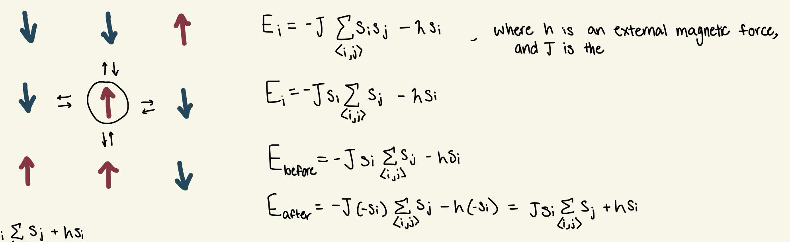





Metropolis-Hastings Algorithm
A Monte-Carlo Simulation
The algorithm finds the equilibrium state in the magnet at a particular temperature. We initialize with a random distribution of spin up and spin down particles (represented with a +1 or -1), and iterate over the system:
Get the current state of the lattice, $E_{i}$
Pick a random particle on the lattice and flip the spin sign, $E_{j}$. Calculate the change in energy induced by this sign change, $ΔE=E_{j}−E_{i}$. We want to find the probability that the system will accept this new state and update the system accordingly.
If $ΔE<0, P\left(i→j\right)=1$. The flip is favored and the sign change is accepted.
If $ΔE≥0,P\left(i →j\right)=e^{−βΔE}$ . The change will be accepted based on the probability from the detailed balance principle.
Repeat $n^{2}$times per step to $≈$ update each particle once
Energy Equation
$$E_{μ}=−J\sum_{<i,j>}{S_{i}S_{j} }$$
$$E_{μ}=−J\sum_{<i,j>}{S_{i}S_{j} −hS_{i}}$$
ΔE Equation
$$\text{Δ}\text{E}=2JS_{i}\sum_{<i,j>}{S_{j}−hS_{i}}$$
$$\text{Δ}\text{E}=2JS_{i}\sum_{<i,j>}{S_{j}}$$

Slide 6
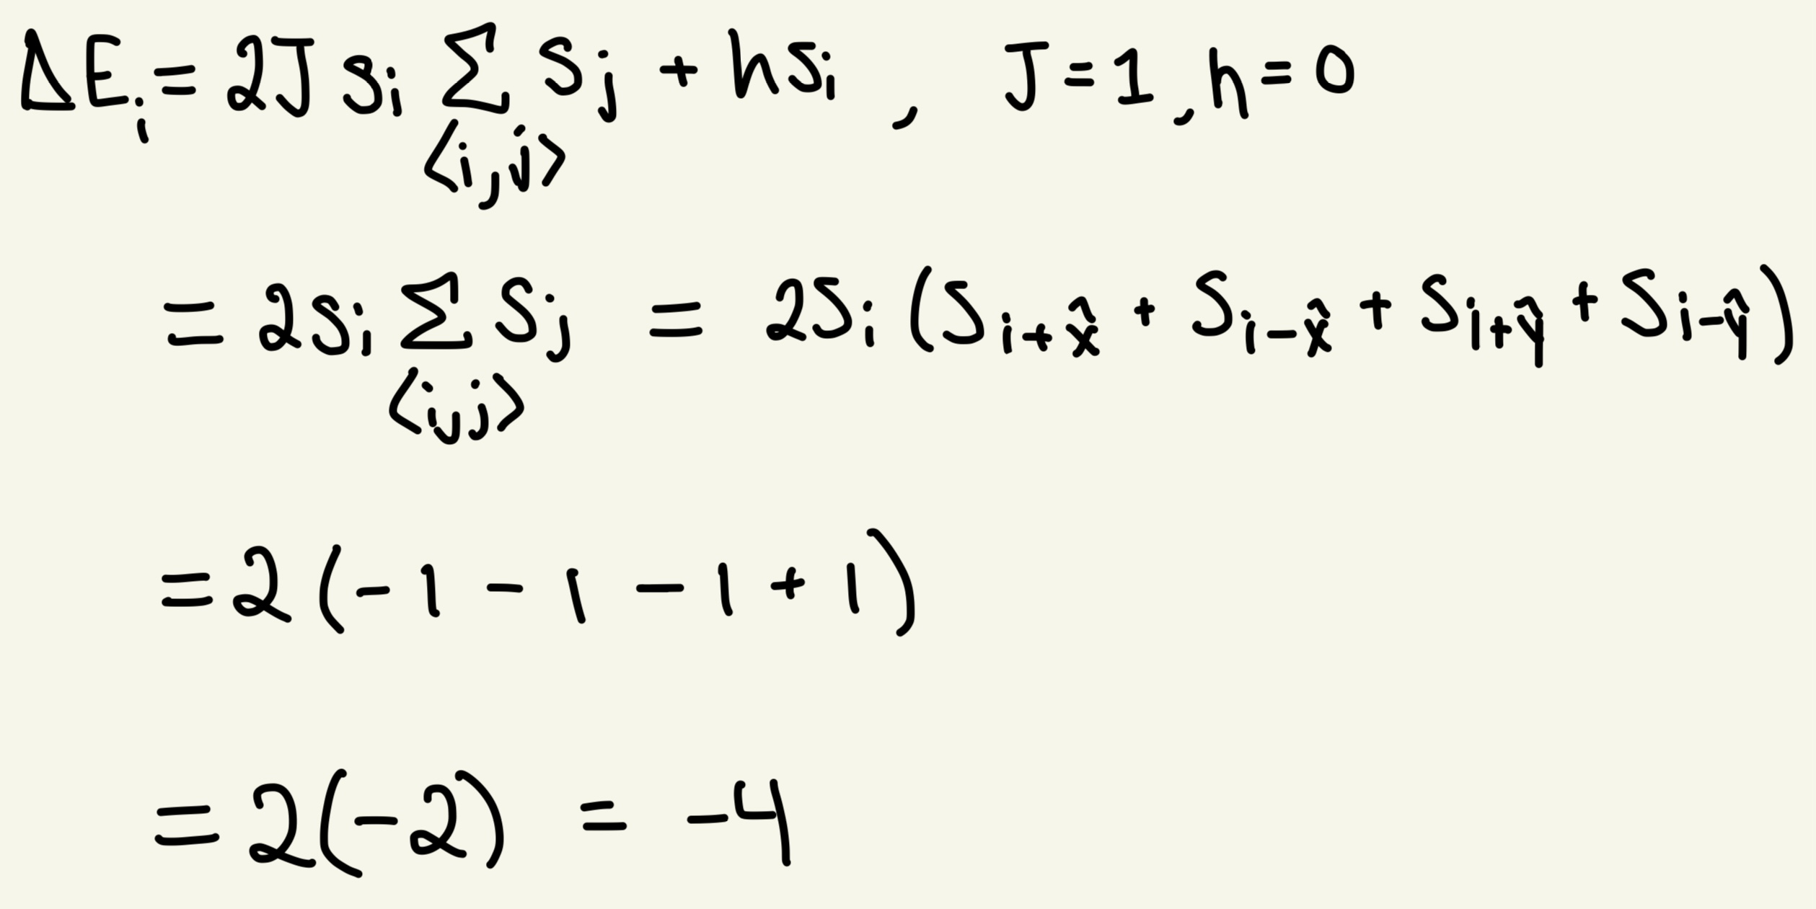
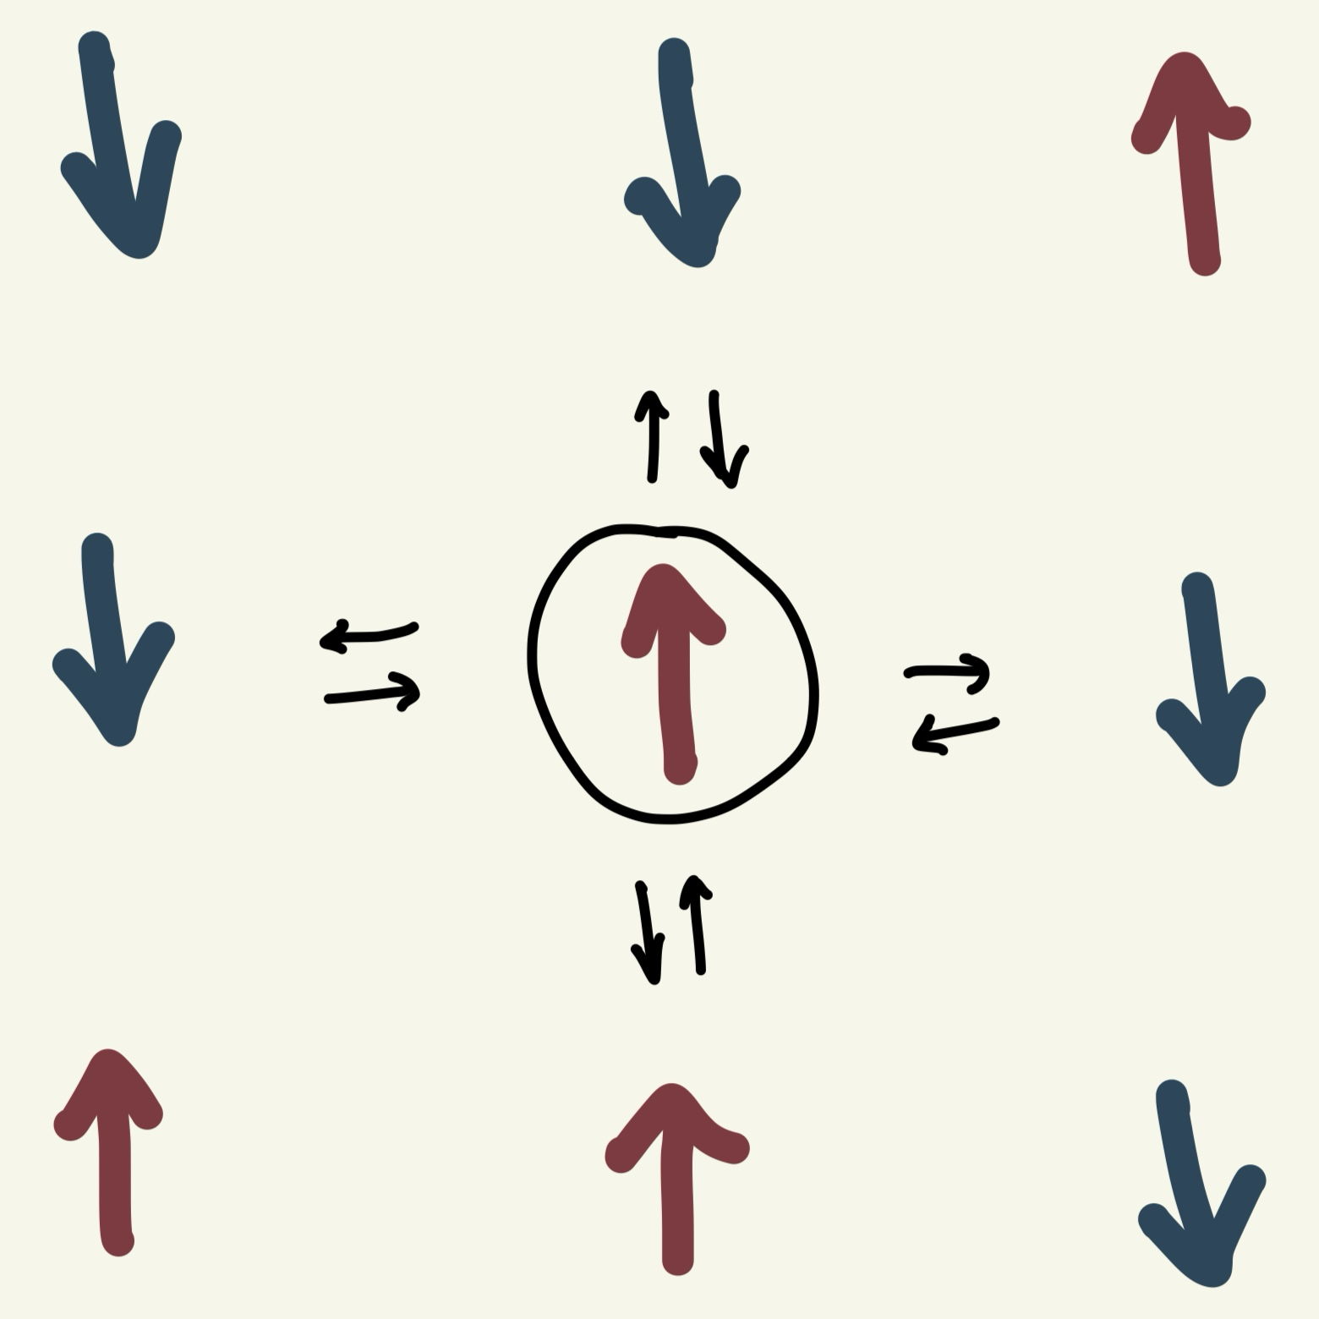
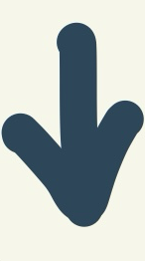

Example
The negative value indicates that the flipped spin moves the system to a lower energy level, and thus is favorable
ΔE Equation
$$\text{Δ}\text{E}=2JS_{i}\sum_{<i,j>}{S_{j}}$$
Notes:
-Ising gave credit to Wilhelm Lenz for inventing the model in his PhD thesis where the model was first proposed. Ising earned the name for it regardless.

Slide 7
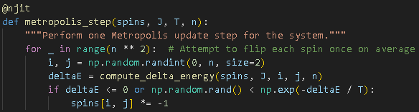
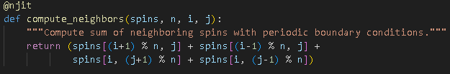
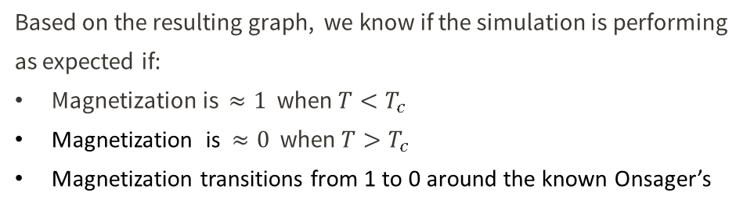
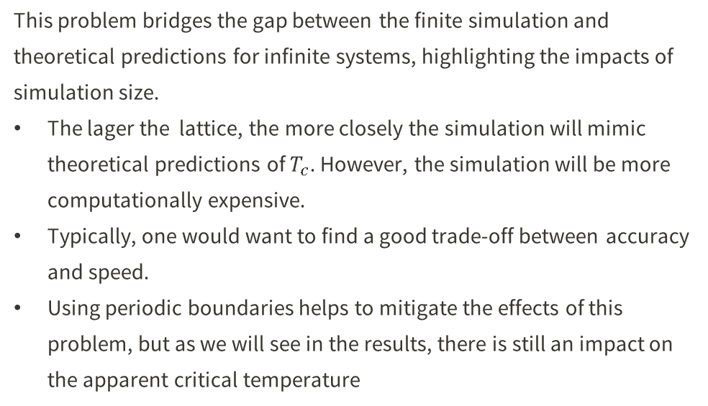
Implementation Details/Edge Cases
1
Boundary conditions
2
Monte Carlo Update Rule
To handle the boundary spins, periodic boundaries are used using modulo/if-else statements
This is the heart of the Metropolis algorithm. We decide whether to flip the spin based on the energy change and the current temperature.
3
Finite-Size Scaling Analysis
This problem bridges the gap between the finite simulation and theoretical predictions for infinite systems, highlighting the impacts of simulation size.
The lager the lattice, the more closely the simulation will mimic theoretical predictions of $T_{c}$. However, the simulation will be more computationally expensive.
Typically, one would want to find a good trade-off between accuracy and speed.
Using periodic boundaries helps to mitigate the effects of this problem, but as we will see in the results, there is still an impact on the apparent critical temperature
4
Testing
Based on the resulting graph, we know if the simulation is performing as expected if:
Magnetization is $≈1$ when $T<T_{c}$
Magnetization is $≈0$ when $T>T_{c}$
Magnetization transitions from 1 to 0 around the known Onsager’s

Slide 8
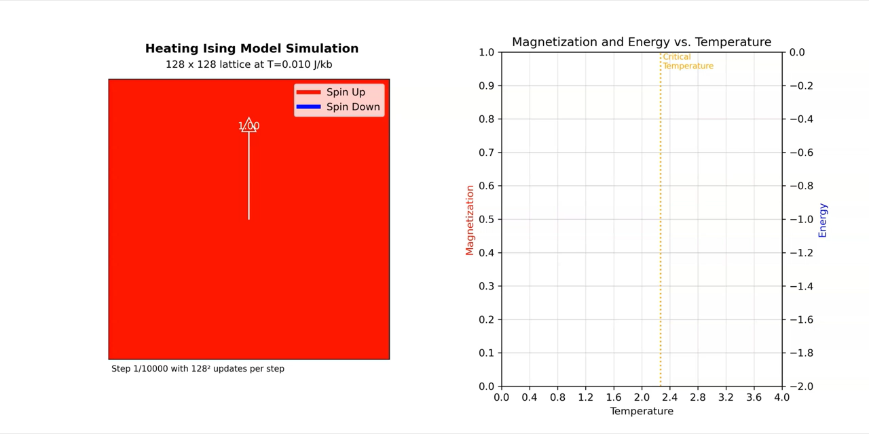
Results - Observing Phase Transitions

Slide 9
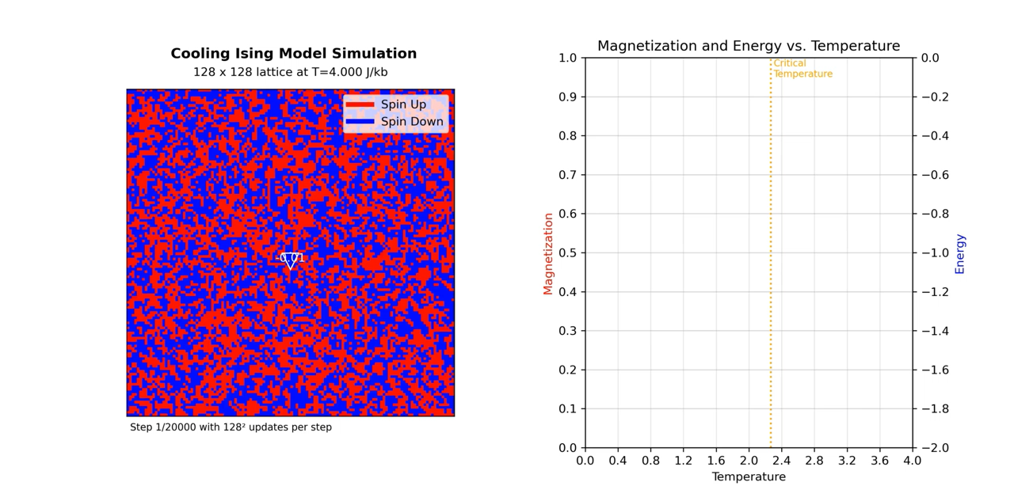
Results - Observing Phase Transitions

Slide 10
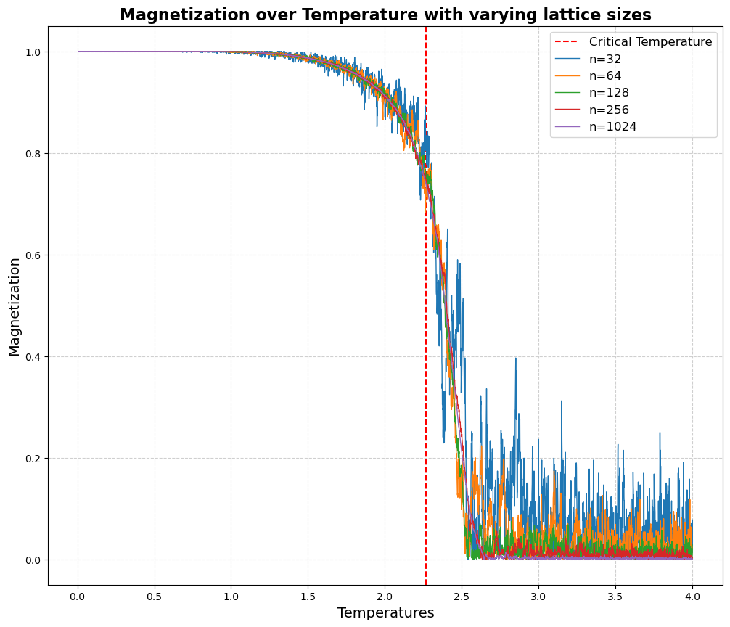
Results – Finite-Scaling Results

Slide 11

Conclusion
Main Goals:
Critical Temperature Verification – Successfully observed phase transition in the 2D Ising model with the estimated $T_{c}$ converging around the known exact solution of $2.269 J/K_{b}$ .
Finite-Size Scaling – Demonstrated proper scaling behavior with system size, showing the effects on accuracy.
Other accomplishments:
Computational Performance- Achieved significant speedup through Numba optimization, enabling simulations of larger lattices in reasonable timeframes.
Visualization- Created dynamic visualizations of the phase transition, showing how magnetization and energy values are affected in real-time.

